Slide 1
Is there a correlation between diabetes and population density?
Team Members: Jose Martinez Carvajal, Peter Kim, Matthieu Dubois, Ashley Peterson

Slide 2
Project Description
Data Sets Used
By using data provided by US Census Bureau and CDC API, we are looking for a correlation between diabetes and population density by county. We will also be looking across 2010-2013 to compare prevalence of diabetes with gender and obesity.
US Population by County created by US Census Bureau (contains age, gender, population & county) 2010
CDC Diabetes by County 2004-2013

Slide 3
Comparing Population Density & Diabetes by State

Slide 4
Correlations between Obesity & Diabetes

Slide 5
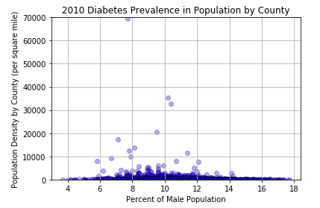
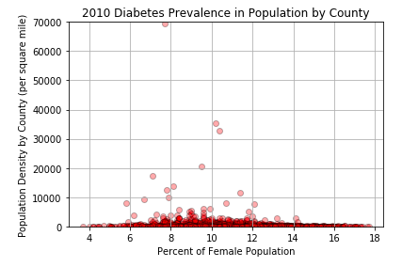
Is diabetes more prevalent in one gender?

Slide 7
Appendix

Slide 8
Resources
CDC Obesity
CDC Gender
Population Density

